Slide 1
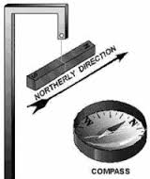
Introduction to Electromagnetism
Ferromagnetic metals can be used to
make magnets: __________________
When a magnet is allowed to rotate freely in the Earth’s magnetic field, one of the pole “seeks” North (______), the other “seeks” south (_______)
A directional _________
is a small magnet!

Slide 2
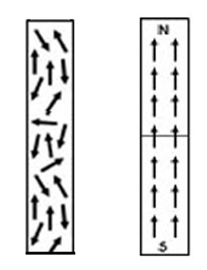
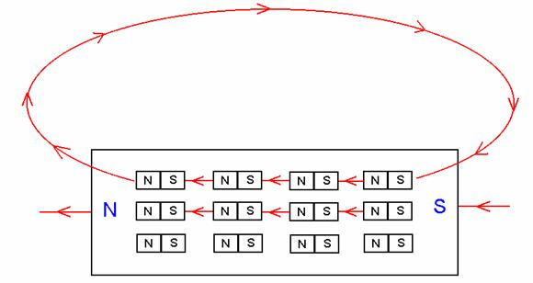
What causes a magnetic material to be magnetized?
Ferromagnetic elements like iron, have groups of atoms with their electron spins aligned. These regions are called _____________and each domain is like a mini-bar magnet.
When the domains _________, the object becomes magnetised. Example:
Not
magnetised
magnetised

Slide 3
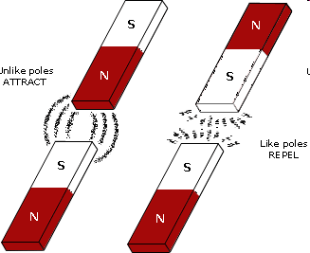
Law of Magnetism
Bar Magnet

Slide 4
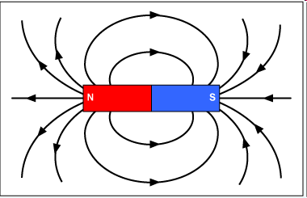
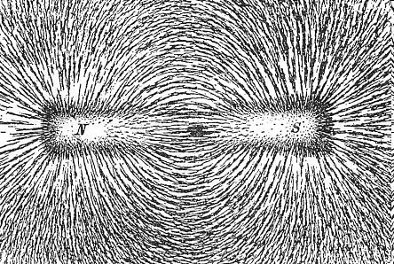
Magnetic Fields
We will call the space around a magnet in which magnetic forces are exerted as a___________________
Iron filings line up along magnetic field lines
Field lines run from __________________
the field lines are more concentrated at the poles.
Lines never cross

Slide 5
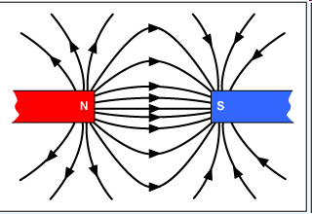
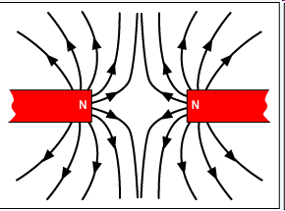
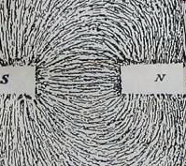
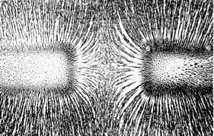
Attraction and Repulsion

Slide 6
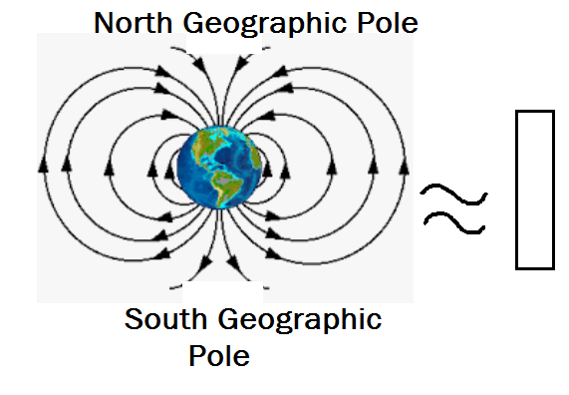
The Earth has its own magnetic field!

Slide 7
Activity 1:
Place two bar magnets pole to pole-close but not touching.
What happens when you place them
N-N:
S-S:

Slide 8
Activity 2:
• Place a plastic sheet on top of a bar magnet:
• Sprinkle iron filings on the sheet:
Describe & draw the pattern you see. Where does the magnetic field seem to be strongest? Why?

Slide 9
Activity 3:
• Place a plastic sheet on top of TWO bar magnets with the N and S poles close but NOT touching.
• Sprinkle iron filings on the sheet:
Describe & draw the pattern you see. Is this showing attraction or repulsion? Why?

Slide 10
Activity 4:
• Place a plastic sheet on top of TWO bar magnets with the N and N poles close but NOT touching.
• Sprinkle iron filings on the sheet:
Describe & draw the pattern you see. Is this showing attraction or repulsion? Why?
Activity 5:
• Repeat activity 4 with the S and S poles close but not touching.Describe & draw the pattern you see. Is this showing attraction or repulsion? Why?

Slide 11
Activity 6:
Investigate the field pattern between the poles
of a horseshoe magnet. What do you observe?
Carefully pour the iron filings back into the beaker!
Activity 7:
What materials are magnetic?
Test copper, aluminum, iron nails, steel paper clips.
Can you turn an paper clip into a magnet?

Slide 12
Activity 8:
• Investigate the direction of the magnetic field by placing small compasses around the magnets. Draw in the direction of the magnetic field by using arrows to show North!
N
N
N
N
s
S

Slide 13
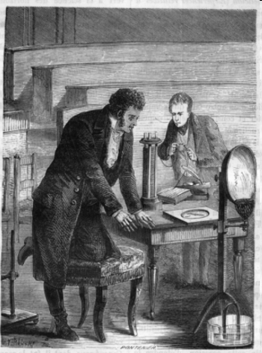
History of Electromagnetism
For centuries, people believed that electricity and magnetism were somehow related. In 1819,
the Danish physicist Hans _________________(1777–1851) discovered the connection by accident while lecturing on electric circuits at the University of
Copenhagen.

Slide 14
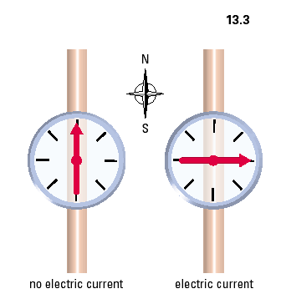
Oersted’s Discovery

Slide 15
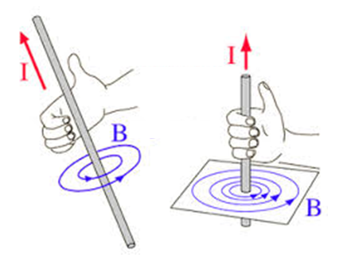
Right Hand Rule #1
Current passing through a straight wire produces a circular magnetic field.
_______________________________
__________________________________
I- direction of conventional current flow
B-magnetic field pattern

Slide 16
Mapping the Field of a Wire
Current into page
Current out of page

Slide 17
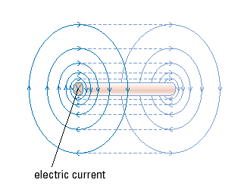
Magnetic Field is 3-Dimensional

Slide 18
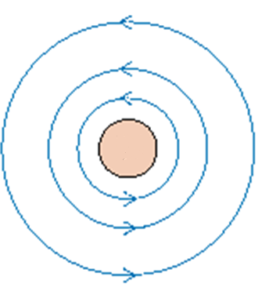
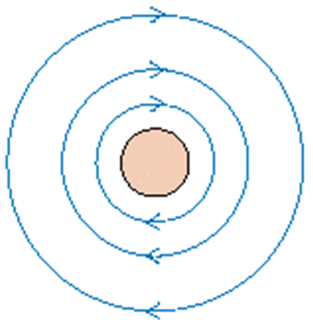
2-D representation:
Conventional current flows
“into” the page
Conventional current flows
out of the page

Slide 19
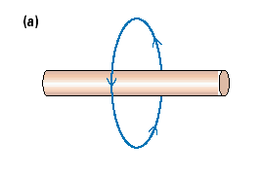
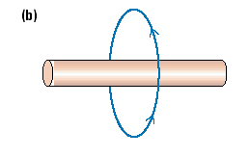
Let’s Try…
c) d)

Slide 20
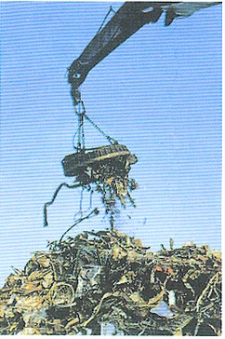
If we can increase the magnetic field around a conductor then we can use the magnetic field!
A crane in a junk yard, can turn its magnetic field off and on to lift a pile of scrap metal and release it using electricity

Slide 21
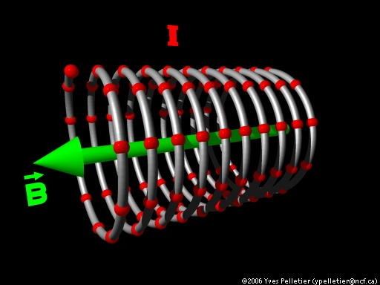
Solenoid
A solenoid represents a coiled loop of wire
Current flows through the coiled loop and creates a magnetic field around the solenoid.
A solenoid is a type
of electromagnet

Slide 22
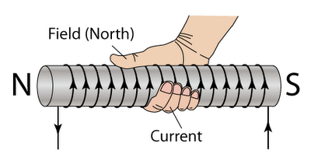
Right Hand Rule #2
•_________ curl in the direction of current flow through the conductor
• _______ points in the direction of the induced magnetic north (N)

Slide 23
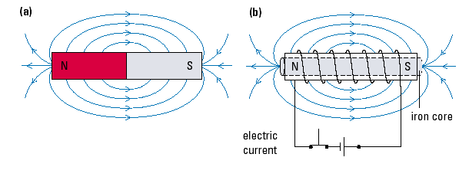
The magnetic field of a solenoid looks like a bar magnet!!
Solenoid

Slide 24
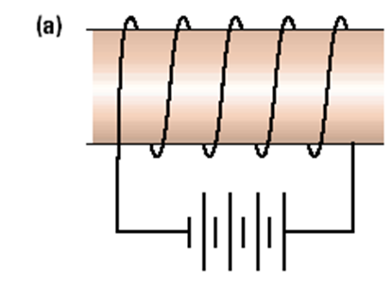
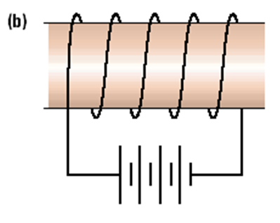
Let’s try...
Indicate on each diagram the direction of the electric current, the magnetic field lines around the coil, and the north and south poles of the coil.

